Slide 1

React query

Slide 2
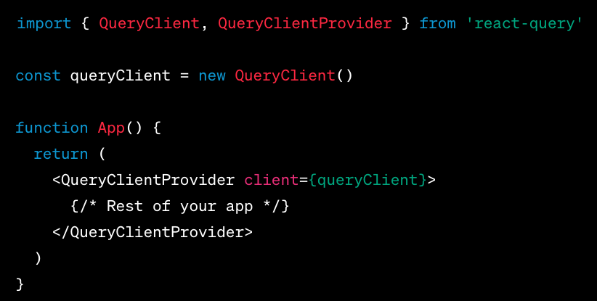
Set up
npm install react-query
You'll want to wrap your React application in the QueryClientProvider component to provide the necessary context.

Slide 3
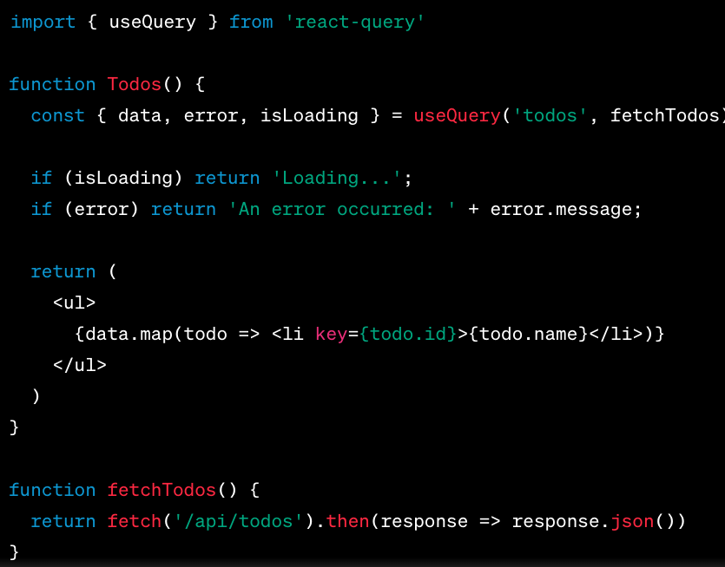
Fetching Data

Slide 4
Key Concepts
Query Keys: The first argument to useQuery is the query key. It's an array or string that uniquely identifies the query. It helps React Query manage and cache the data.
Query Function: The second argument is the function that fetches your data.
Query Result: The useQuery hook returns an object with the query result, which includes properties like data, error, isLoading, etc.

Slide 5


Mutations
When you want to change data on the server, you'll use useMutation:

Slide 6
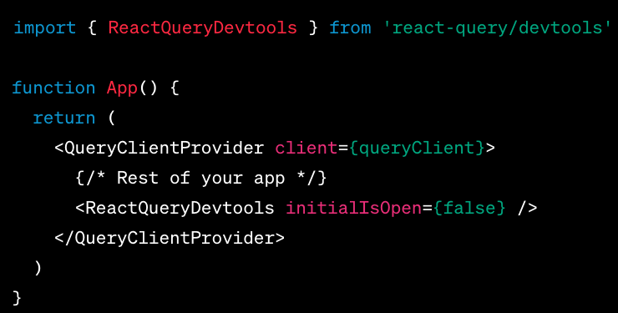
Devtools
npm install react-query/devtools

Slide 7
QueryClientProvider
Global State & Configuration: QueryClient holds the configuration and state for your queries and mutations. By wrapping your application or a part of it with QueryClientProvider, you make the configuration and state globally available to any component within the provider.
Ensures Consistency: Since the QueryClient manages caching, retries, garbage collection, and more, it's essential that there's a single instance being used across your entire app (or a section of it). This ensures consistent behavior and state management.
Allows use of React Query Hooks: React Query hooks like useQuery, useMutation, etc., need access to the QueryClient to function correctly. When you use these hooks inside a component, they automatically tap into the context provided by the QueryClientProvider to get the required configuration and state. Without this provider, these hooks wouldn't know how to behave or access the cache.
Flexibility: By allowing you to define your QueryClient and its configurations, React Query gives you the flexibility to have different configurations for different parts of your application, if needed. For example, you could wrap different parts of your app with different providers if they required distinct query behaviors.
Integration with Devtools: The QueryClient also plays a role in integrating with React Query Devtools for debugging and development purposes.

Slide 8
What we will do
https://blog.jarrodwatts.com/level-up-your-full-stack-development-with-react-query

Slide 9
useMutation
Optimistic Updates
Auto Retries
Callbacks: onMutate, onSuccess, onError, onSettled
Invalidate and Refetch Queries

Slide 10
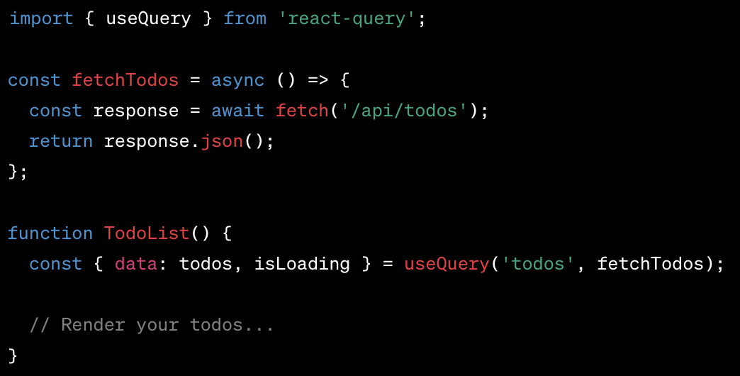
Use Query

Slide 11
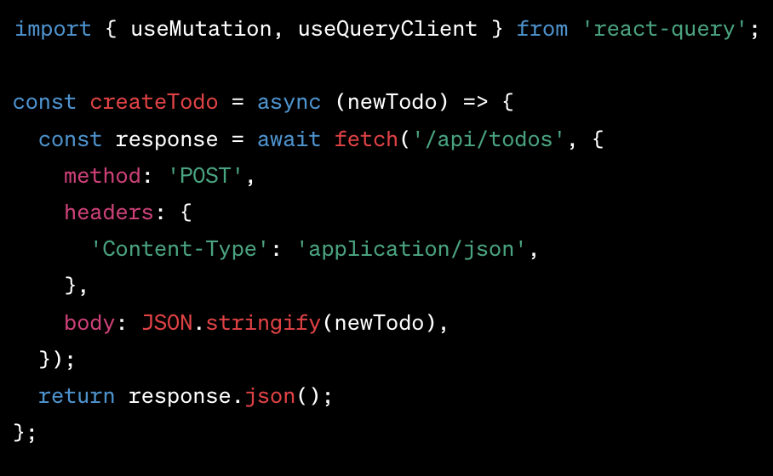
useMutation

Slide 12
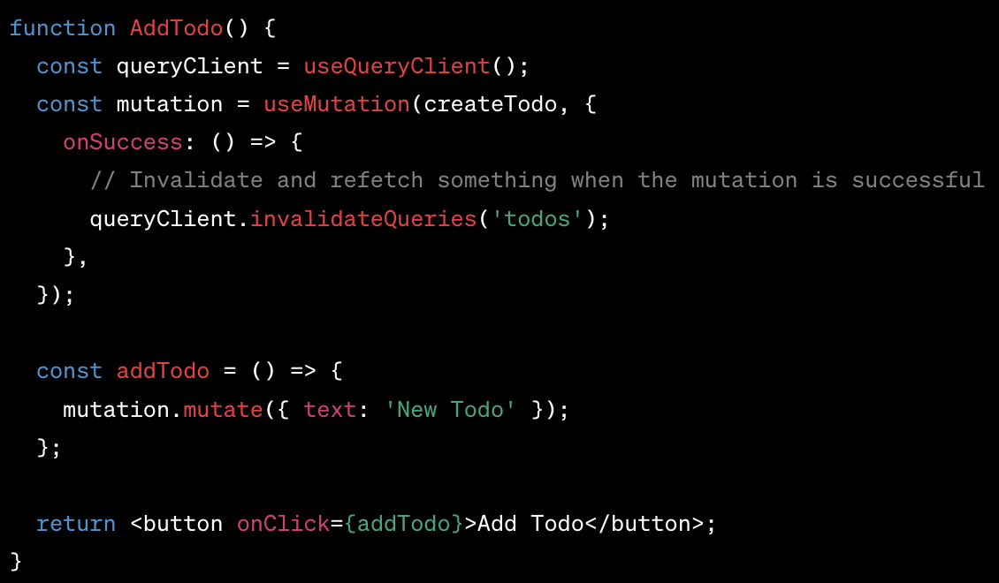
Second part

Slide 13
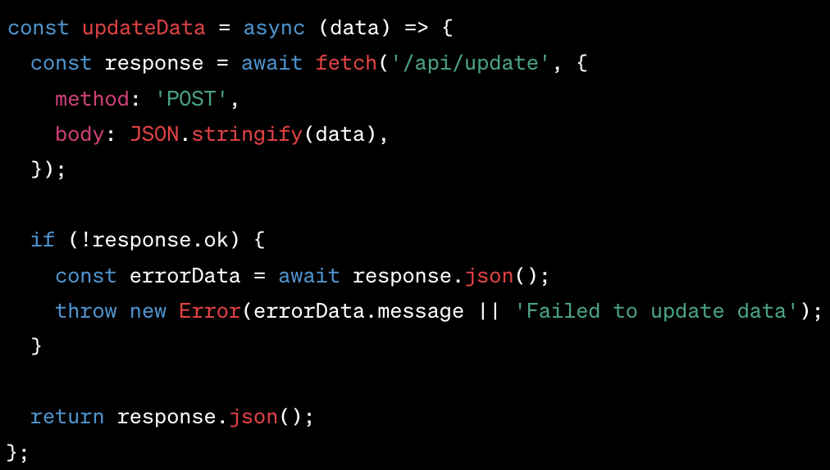
What about errors?

Slide 14
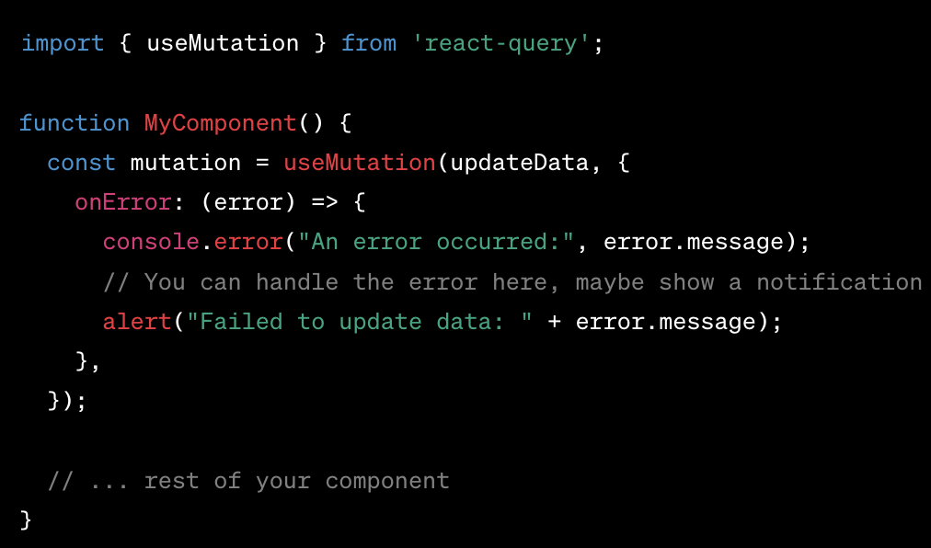
Handle error

Slide 15
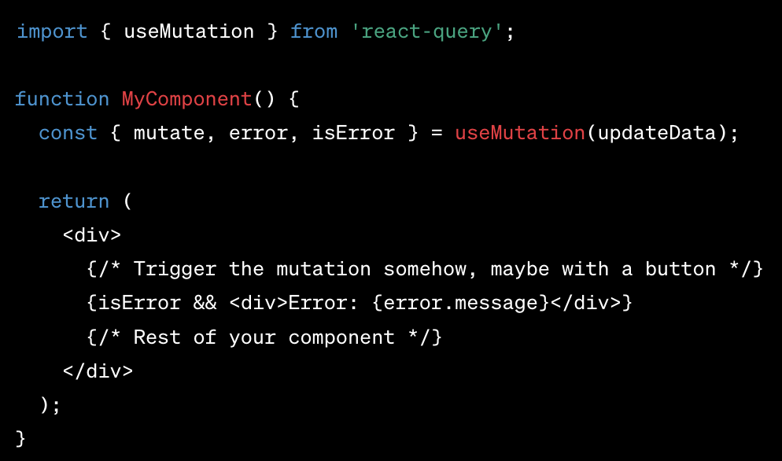
Second way

Slide 16
More hooks
useQuery: Fetches data and handles auto-refetching.
useQueries: Fetches multiple queries concurrently.
useInfiniteQuery: Handles paginated and "infinite" data fetching scenarios.
useMutation: Manages data mutations (like POST, PUT, DELETE).
useQueryClient: Gives access to the QueryClient for advanced operations.
useIsFetching: Indicates how many queries are currently fetching.
useIsMutating: Shows the number of ongoing mutations.
useHydrate and useHydrateQueries: Aid in hydrating state, useful for SSR or local state synchronization.

Slide 17
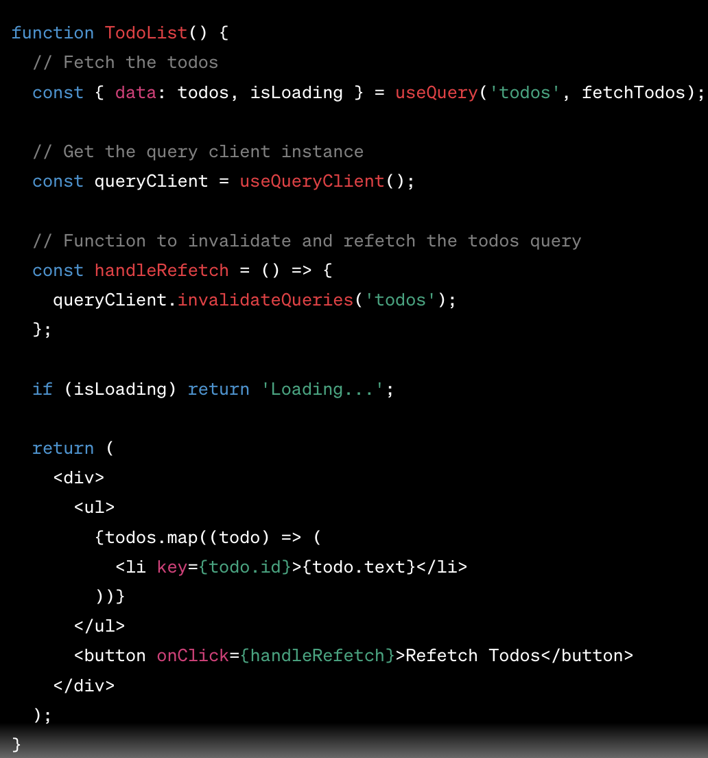
More control

